Slide 1

GitHub Language Dominance
1,200
12
A Comprehensive Analysis of 1,200 Repositories Across 12 Programming Languages
Repositories
Languages
43.4M
6.8M
Capstone Project - Data-Driven Insights into Programming Language Ecosystem Health, Popularity, and Activity
Total Stars
Total Forks
Data Analysis Capstone Project
GitHub Repository Ecosystem Study

Slide 2

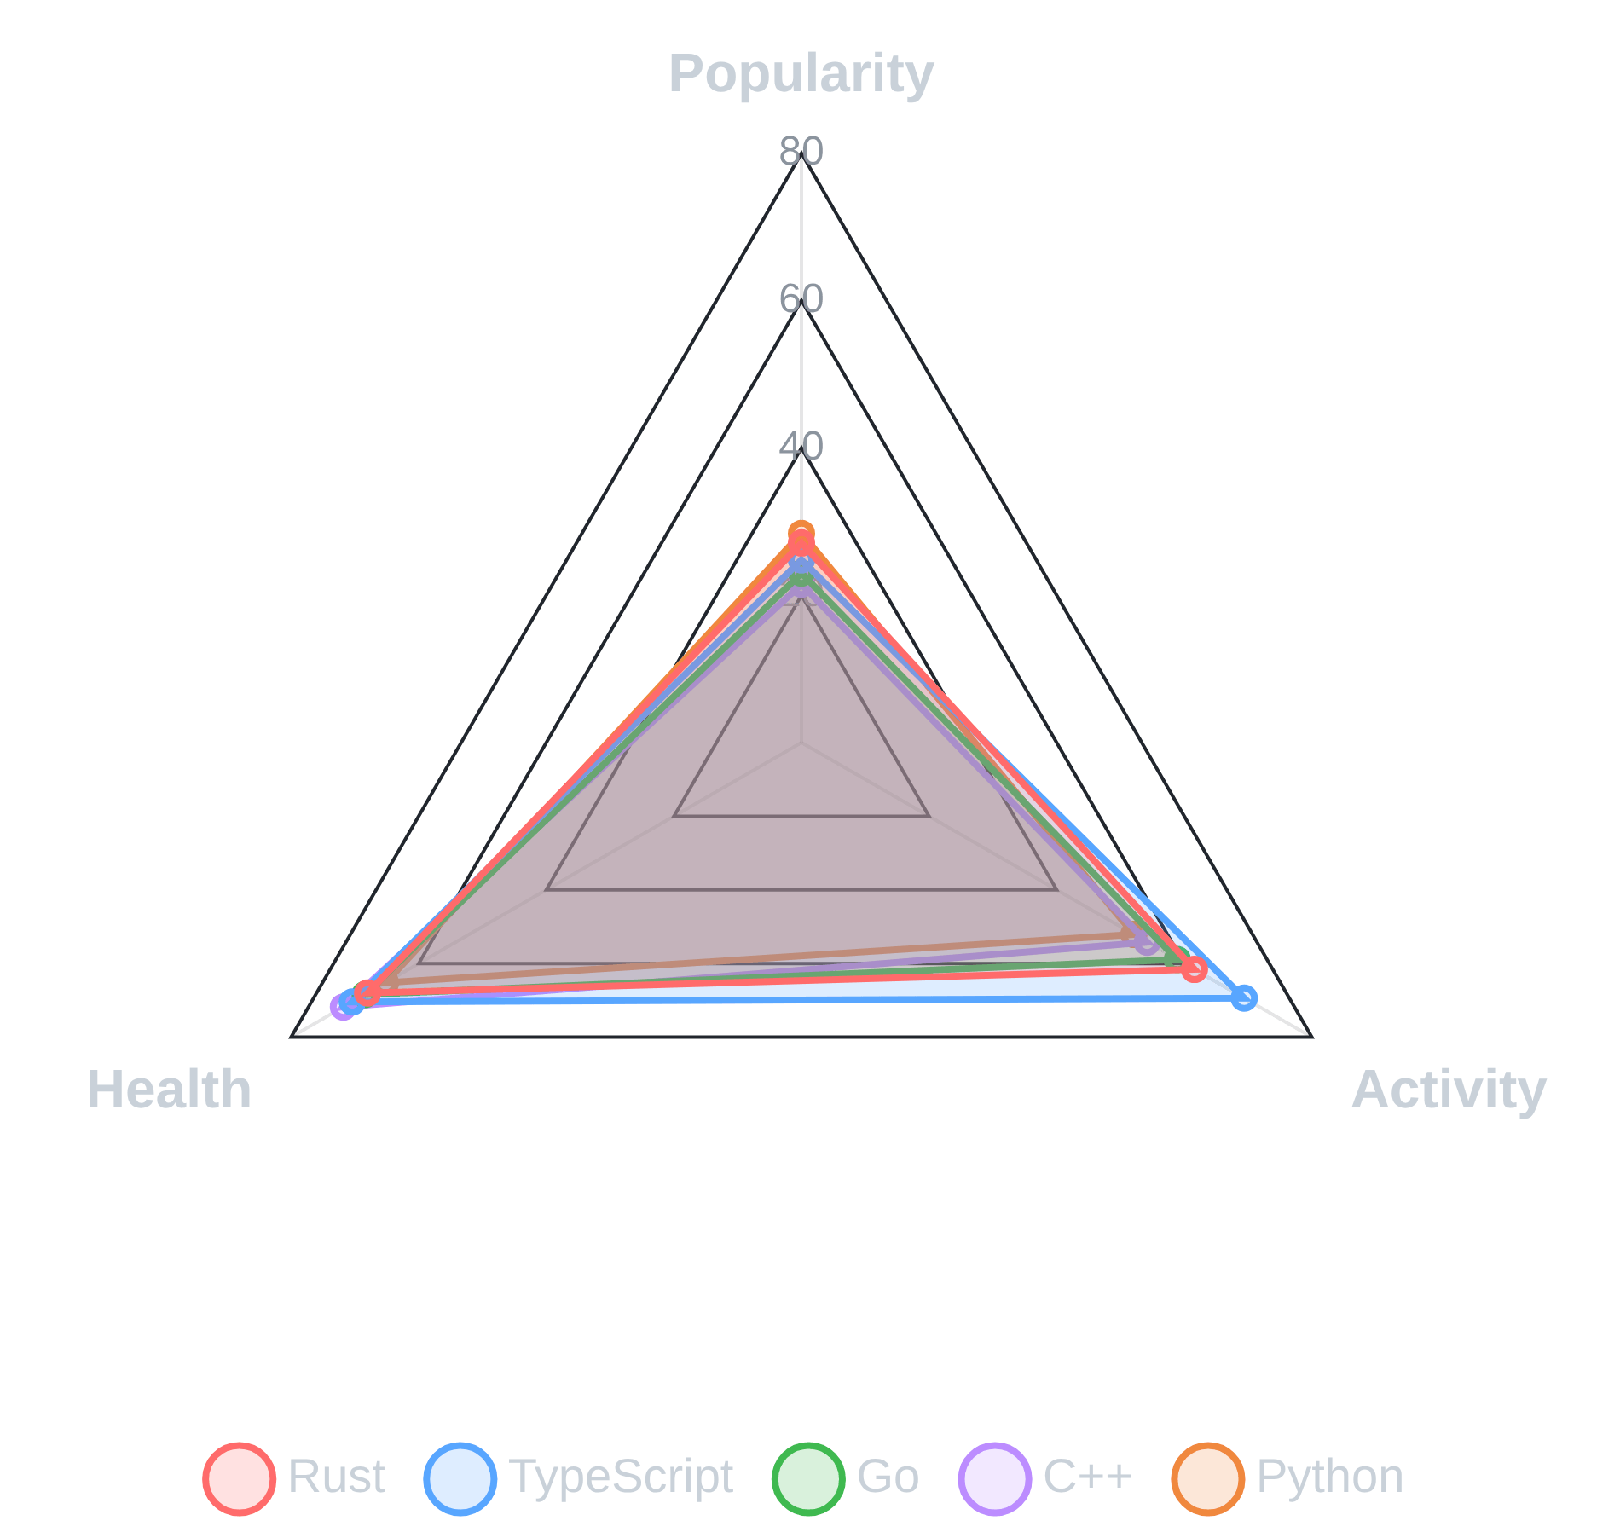
Project Overview and Research Questions
Understanding Programming Language Ecosystems Through GitHub Repository Analysis
Analyzed
1,200 repositories
(100 per language) across 12
major programming languages to understand ecosystem
health and developer engagement
Examined
43.4 million stars
and
6.8 million forks
to measure
community popularity and contribution patterns
Evaluated repositories across three critical dimensions:
Popularity (40% weight)
Health (25% weight)
,
Activity (35% weight)
, and
Research questions focused on identifying which languages demonstrate the strongest community engagement and what factors drive repository success
Methodology employed
normalized scoring (0-100 scale)
to
enable fair cross-language comparisons despite varying
repository sizes

Slide 3

Dataset and Methodology
Rigorous Data Collection and Multi-Dimensional Scoring Framework Ensures Robust Analysis
Data Collection
Popularity Metrics
Activity Metrics
1,200 repositories sourced from GitHub API, with 100 top repositories per language selected based on star count to ensure quality representation
Stars (community appreciation), forks (code reuse), and watchers (ongoing interest), normalized to 0-100 scale
Commits across three time windows (30, 90, and 365 days) plus contributor counts to measure development velocity
Health Indicators
Composite Scoring
Statistical Validation
README files (99.3% coverage), licenses (94.2% coverage), contributing guidelines, and codes of conduct
Overall score calculated as weighted composite: Popularity (40%) + Activity (35%) + Health (25%)
ANOVA testing confirms significant differences between language groups, validating observed rankings

Slide 4

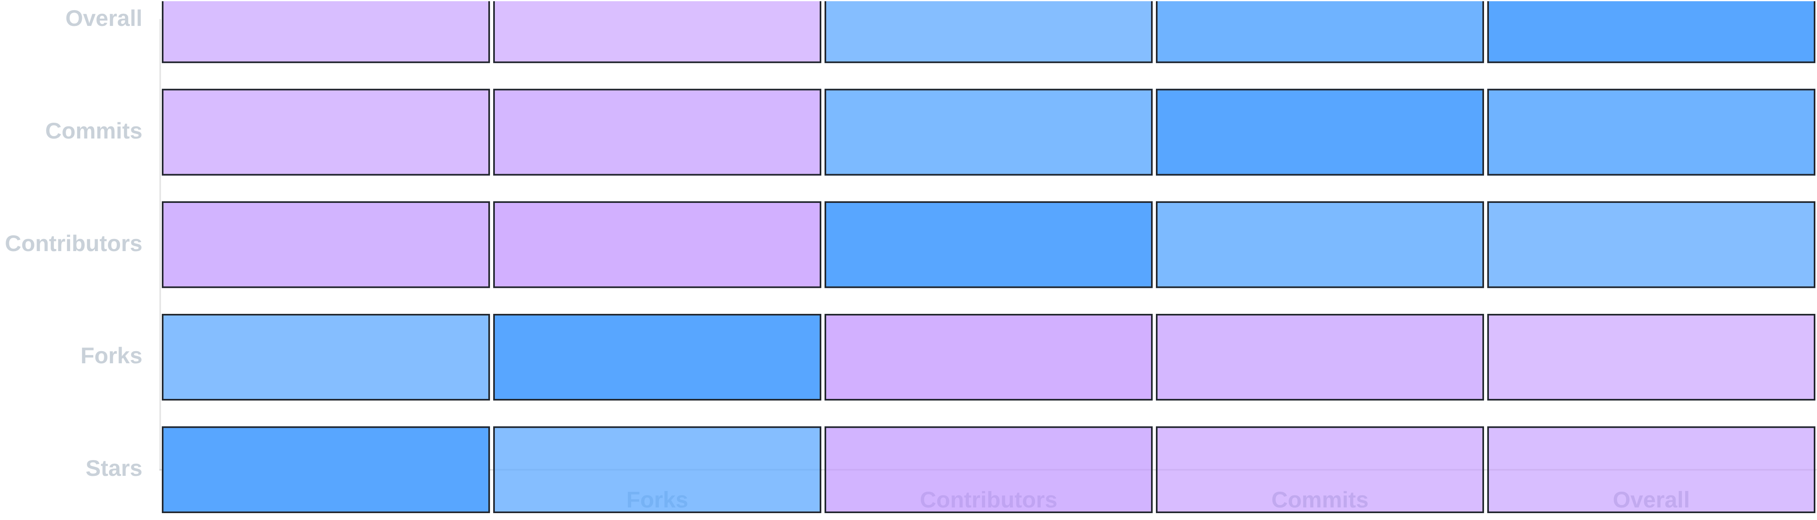
Metric Correlations
Understanding Relationships Between Success Factors
Correlation Matrix: Relationships Between Metrics
0.86
0.78
0.73
Commits × Overall Score
Contributors × Commits
Stars × Forks
Strongest Predictor
High Collaboration Impact
Popularity Alignment

Slide 5

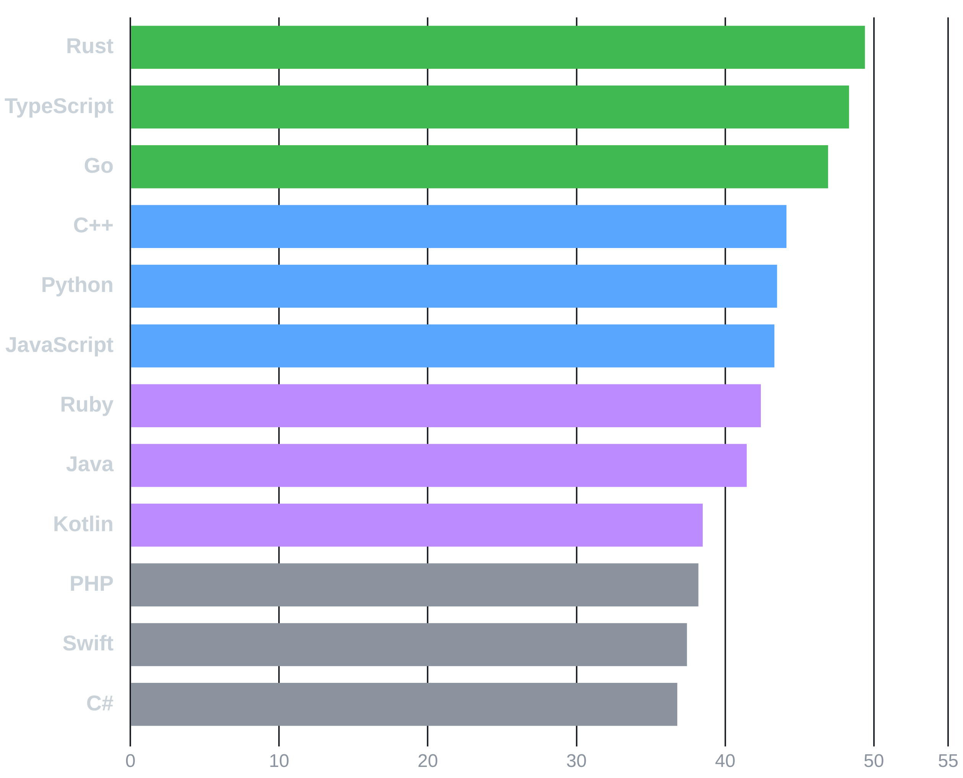
Language Rankings - Overall Performance
Rust, TypeScript, and Go Lead Overall Rankings with Balanced Strength Across All Dimensions
Top Performer
Rust claims top position with
49.4
overall
Overall Score Rankings (All 12 Languages)
score, demonstrating exceptional activity (61.6)
and health (68.0)
Second Place
TypeScript ranks second at
48.3
overall,
achieving highest activity score (69.4) and
strong health (70.4)
Third Place
Go secures third with
46.9
overall score
through balanced performance across all
metrics
Statistical Significance
ANOVA testing confirms significant differences between language groups (p < 0.05), validating genuine ecosystem variations

Slide 6

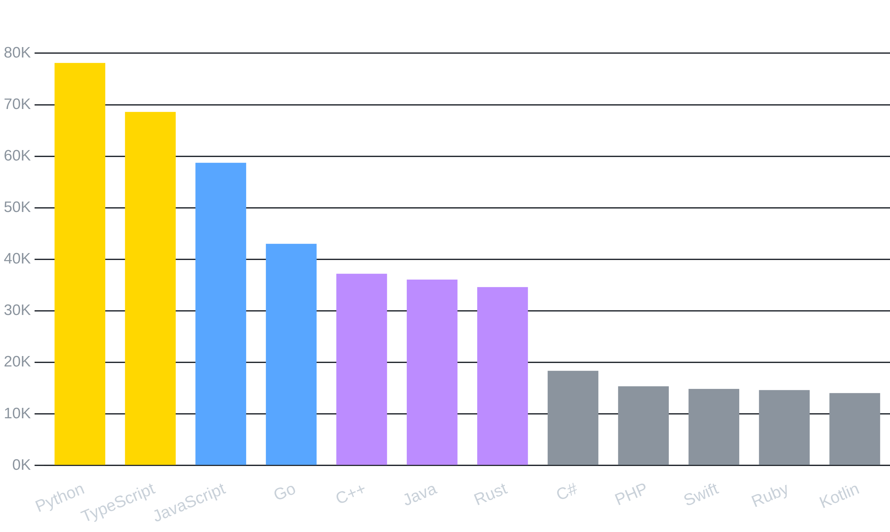
Understanding Popularity Metric Distribution
Why Raw Star Counts Can Be Misleading Without Normalization
Power-Law Distribution
Popularity metrics follow a power-law distribution where a few languages dominate absolute numbers while most cluster in lower ranges
5.2x
Python's Advantage
Python's 78K avg stars is 5.2× higher than Swift's 15K, creating massive skew in raw comparisons
Normalization Solution
We normalize to 0-100 scale within each metric, enabling fair cross-language comparison regardless of absolute magnitude
Beyond Popularity
Activity (r=0.85) and Health metrics prove more predictive of success than raw popularity (r=0.57)

Slide 7

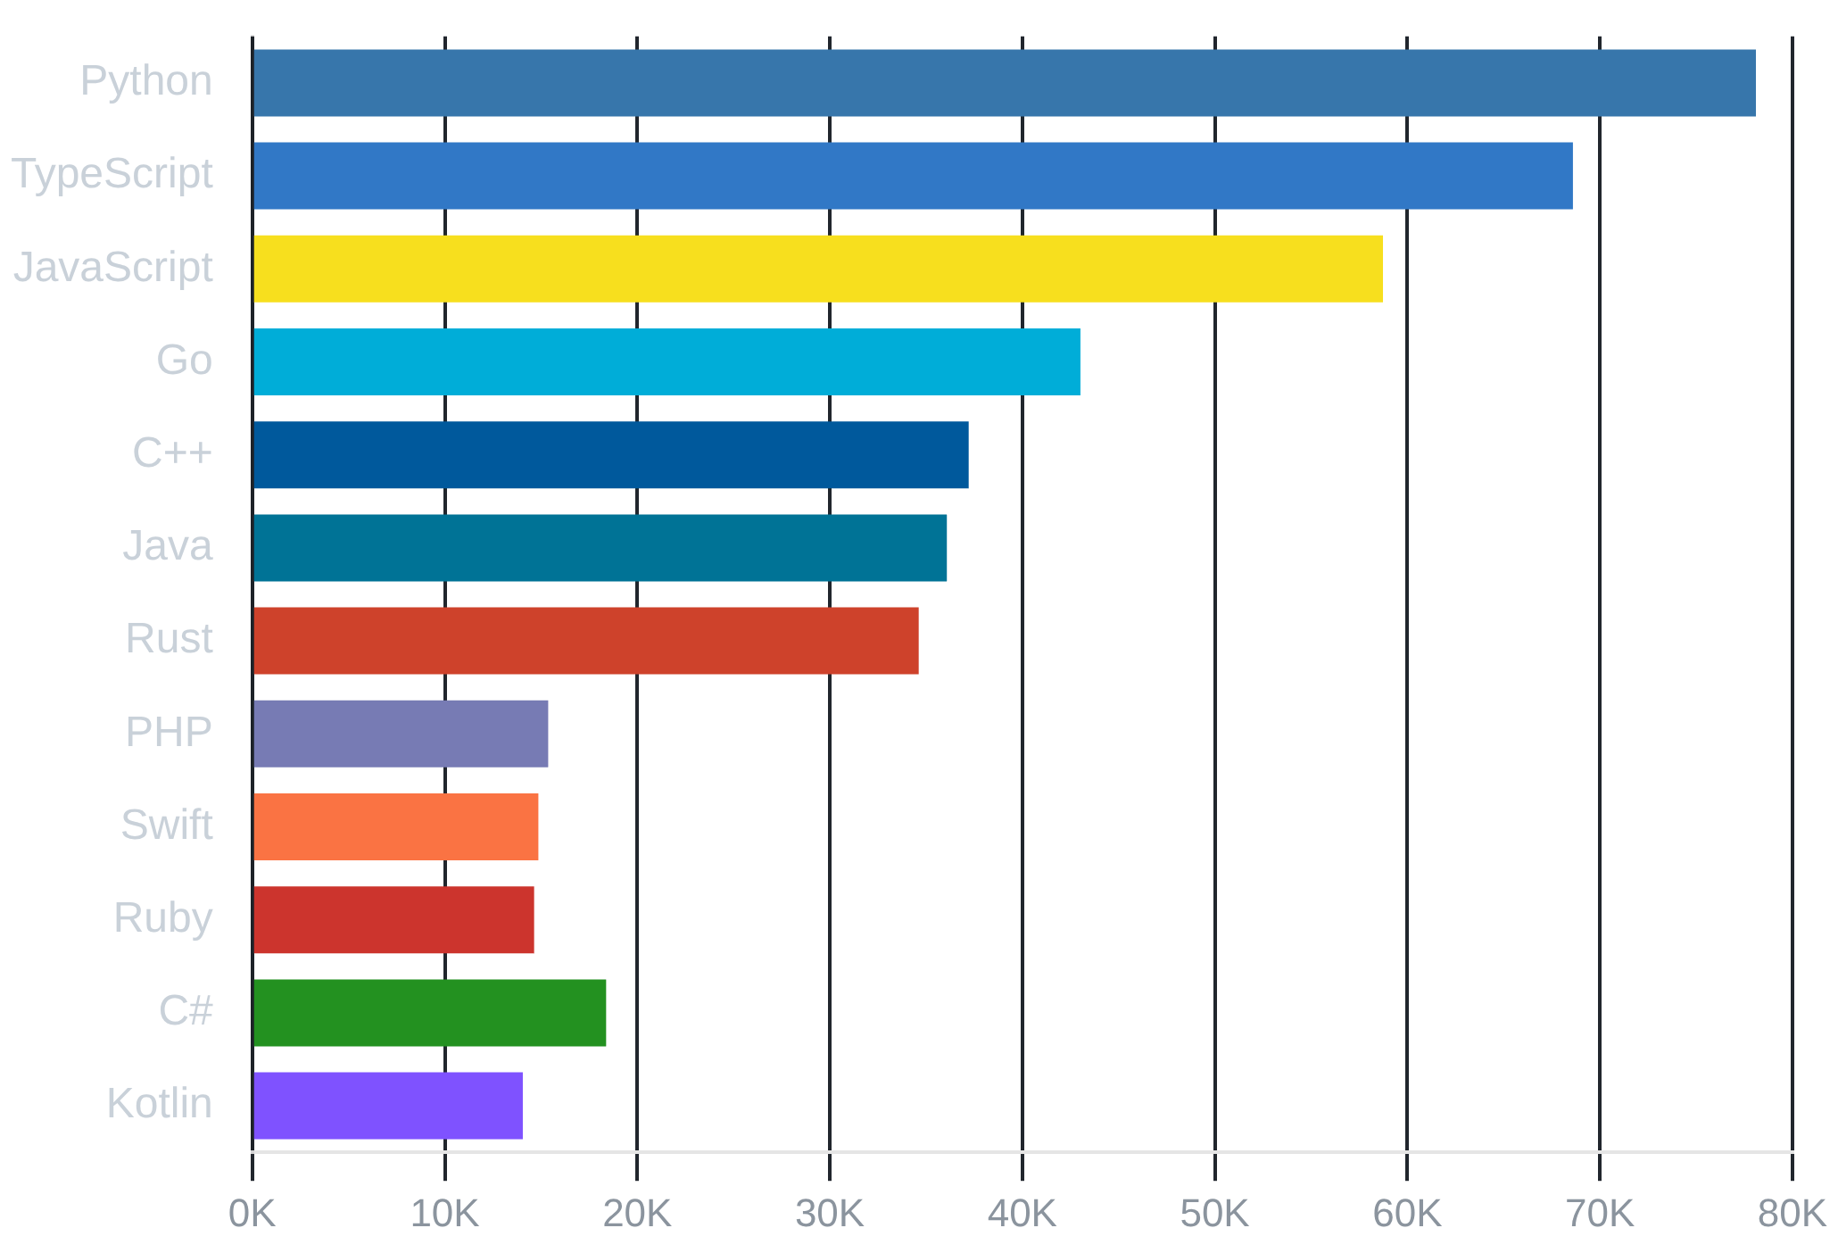
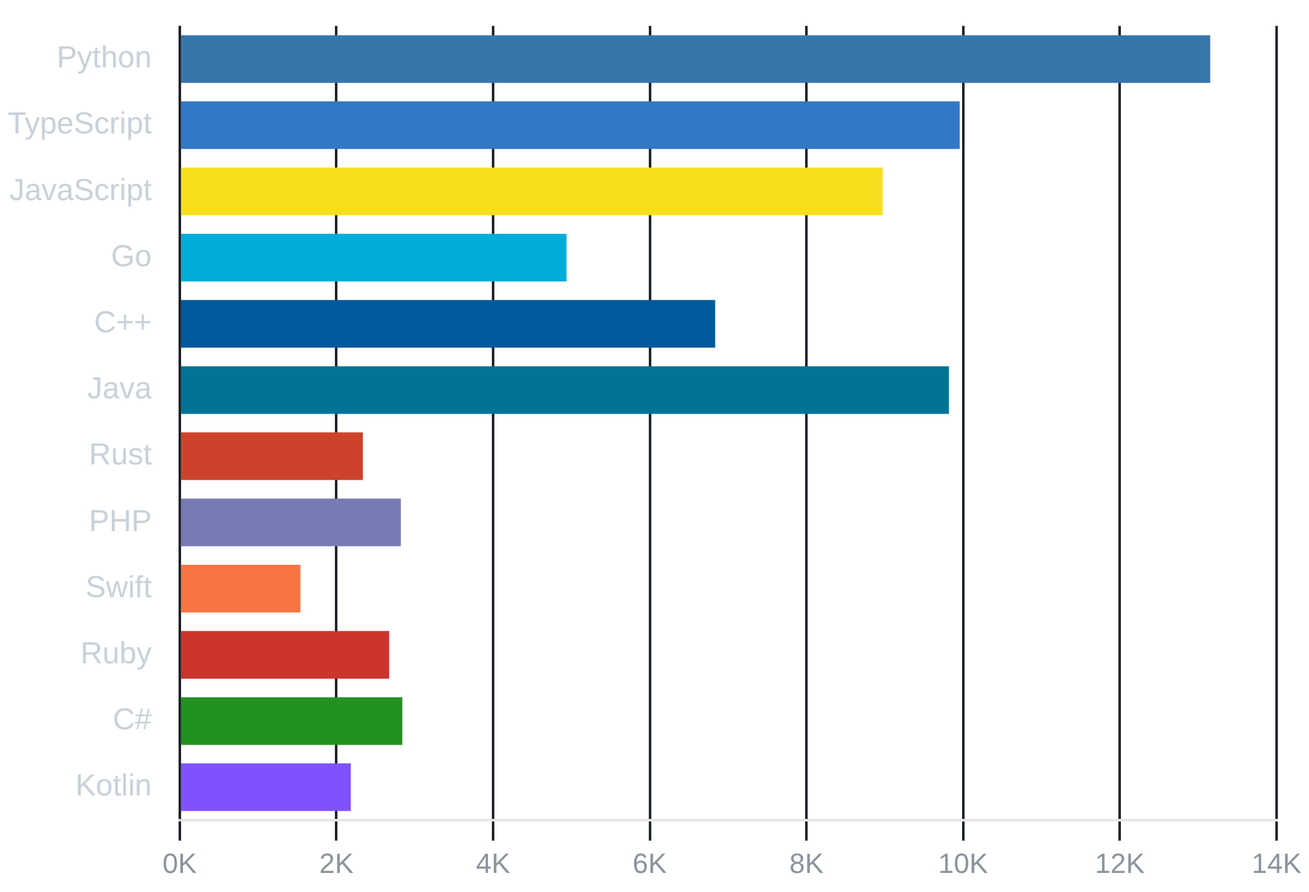
Popularity Analysis - Community Engagement Patterns
Python Dominates Total Stars While TypeScript Commands Highest Average Repository Engagement
Highest Avg Stars
Second Highest
Highest Avg Forks
Stars-to-Forks Ratio
78,107
68,602
13,154
0.161
Python - Broad adoption across domains
TypeScript - High-quality projects
Python - Strong code reuse
~1 fork per 6 stars average
Average Stars per Repository
Average Forks per Repository

Slide 8

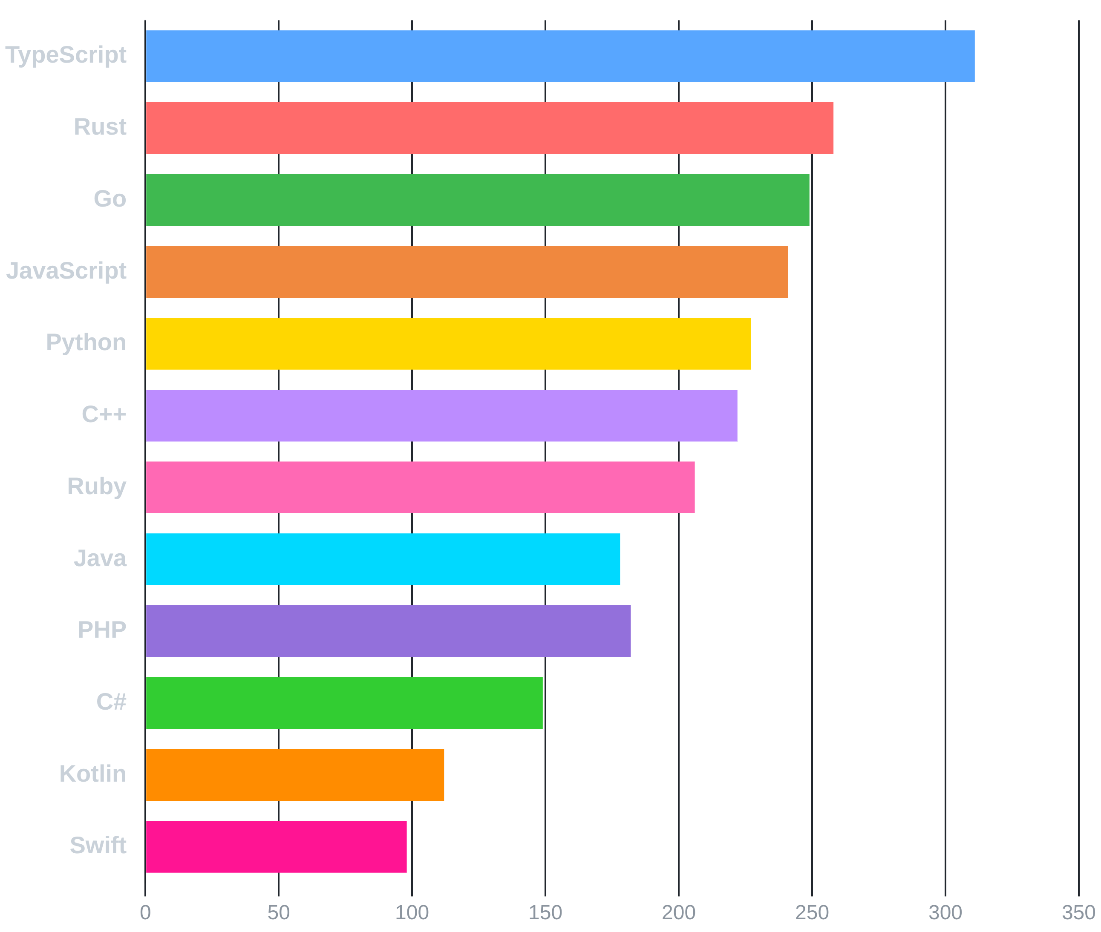
Activity Analysis - Development Velocity
TypeScript and Rust Demonstrate Highest Development Activity with Superior Contributor Engagement
311
TypeScript Leads
Highest average contributors per repository, indicating strong collaborative development culture
258
Rust Second
Active community despite smaller total repository count, showing high engagement
98
Swift Lowest
Lowest contributor count suggests concentrated development or platform-specific constraints

Slide 9

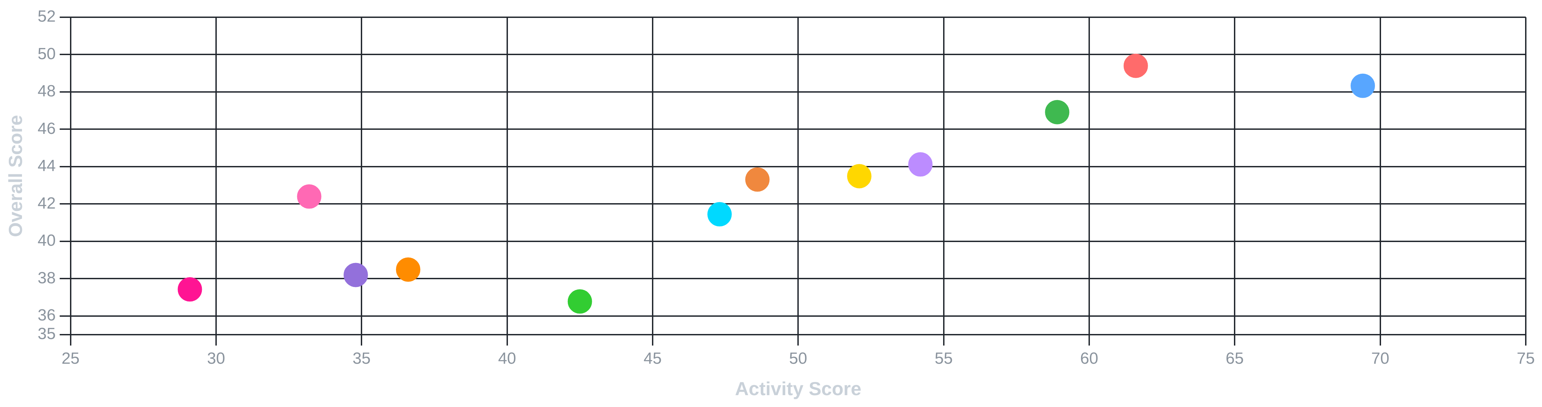
Activity Correlation Analysis
Activity Score Emerges as Strongest Predictor of Language Ecosystem Success
Activity Score vs Overall Score Correlation (r = 0.85)
0.85
29.1
36.6
Correlation Coefficient
Swift Activity Score
Kotlin Activity Score
Strong positive correlation confirms active development is the strongest predictor of ecosystem success
Lowest activity score among all languages, suggesting maturation or platform-specific development constraints
Second lowest activity, indicating reduced innovation pace or concentrated development efforts

Slide 10

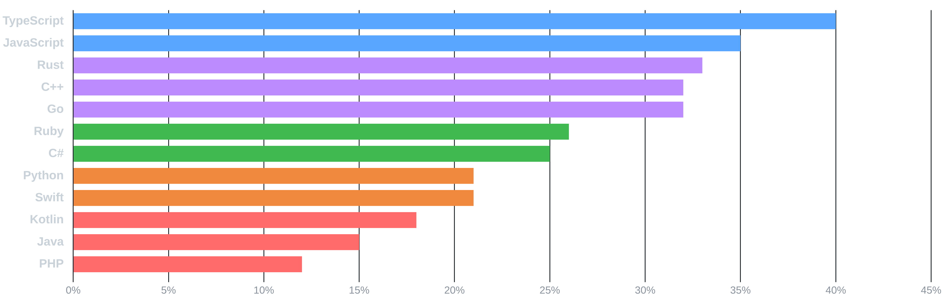
Enterprise Readiness Assessment
TypeScript and JavaScript Lead Enterprise Adoption with Strong Compliance Foundations
40%
0.79
+15%
TypeScript Leader
Top Compliance
Adoption Gap
Highest enterprise-ready percentage with strong compliance score (0.79)
TypeScript compliance score correlates directly with enterprise adoption rate
Modern languages (TS, JS, Rust) outperform traditional ones (Java, PHP) by 15-25%

Slide 11
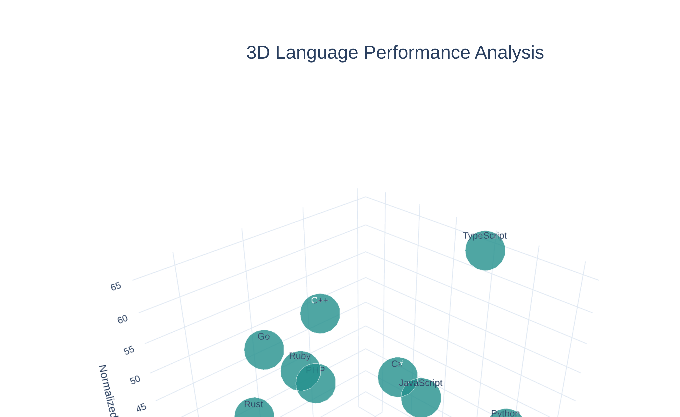
3D Language Ecosystem Visualization
Interactive Exploration of Popularity, Activity, and Health Dimensions
🔄
Interactive
Rotate and zoom to explore language positioning across three key dimensions
📊
Clustering
Modern languages (Rust, TypeScript, Go) cluster in high-activity, high-health region
🎯
Patterns
Traditional languages spread across lower activity zones despite high popularity

Slide 12

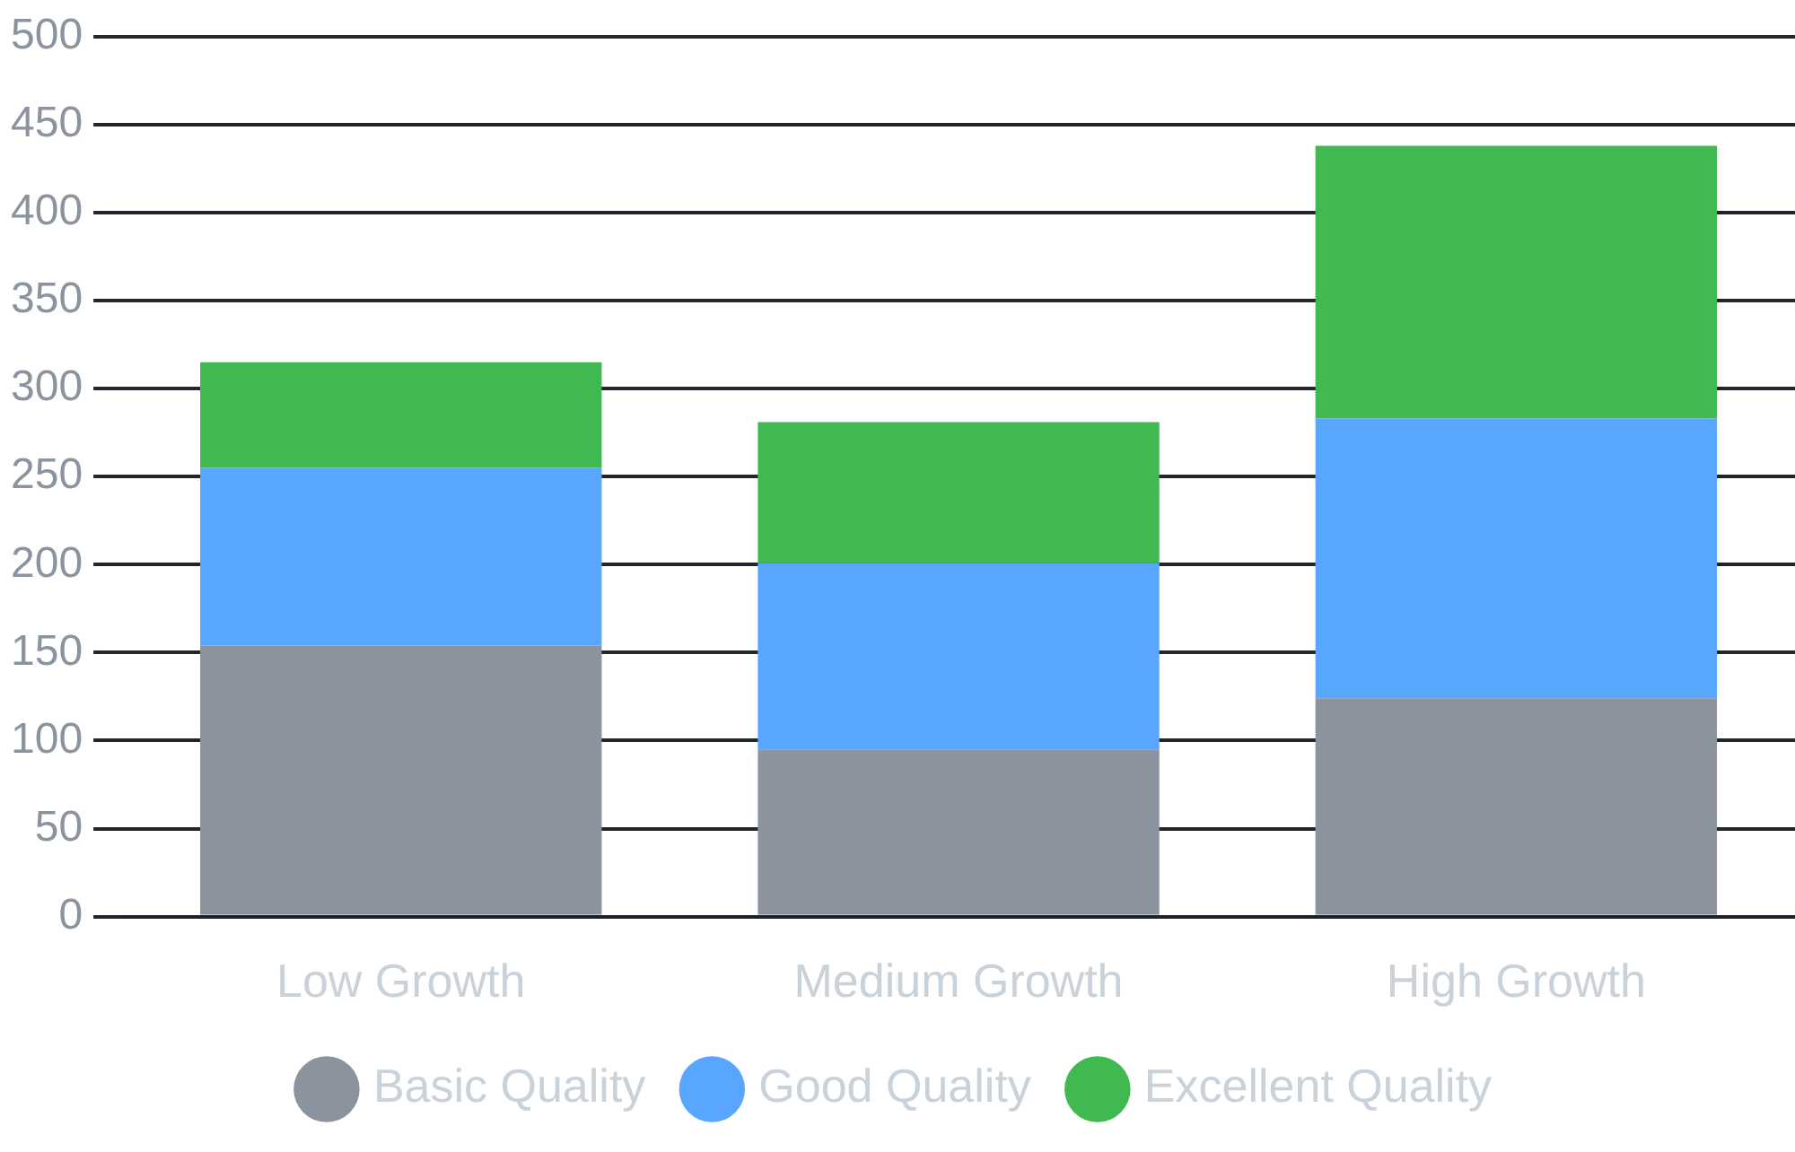
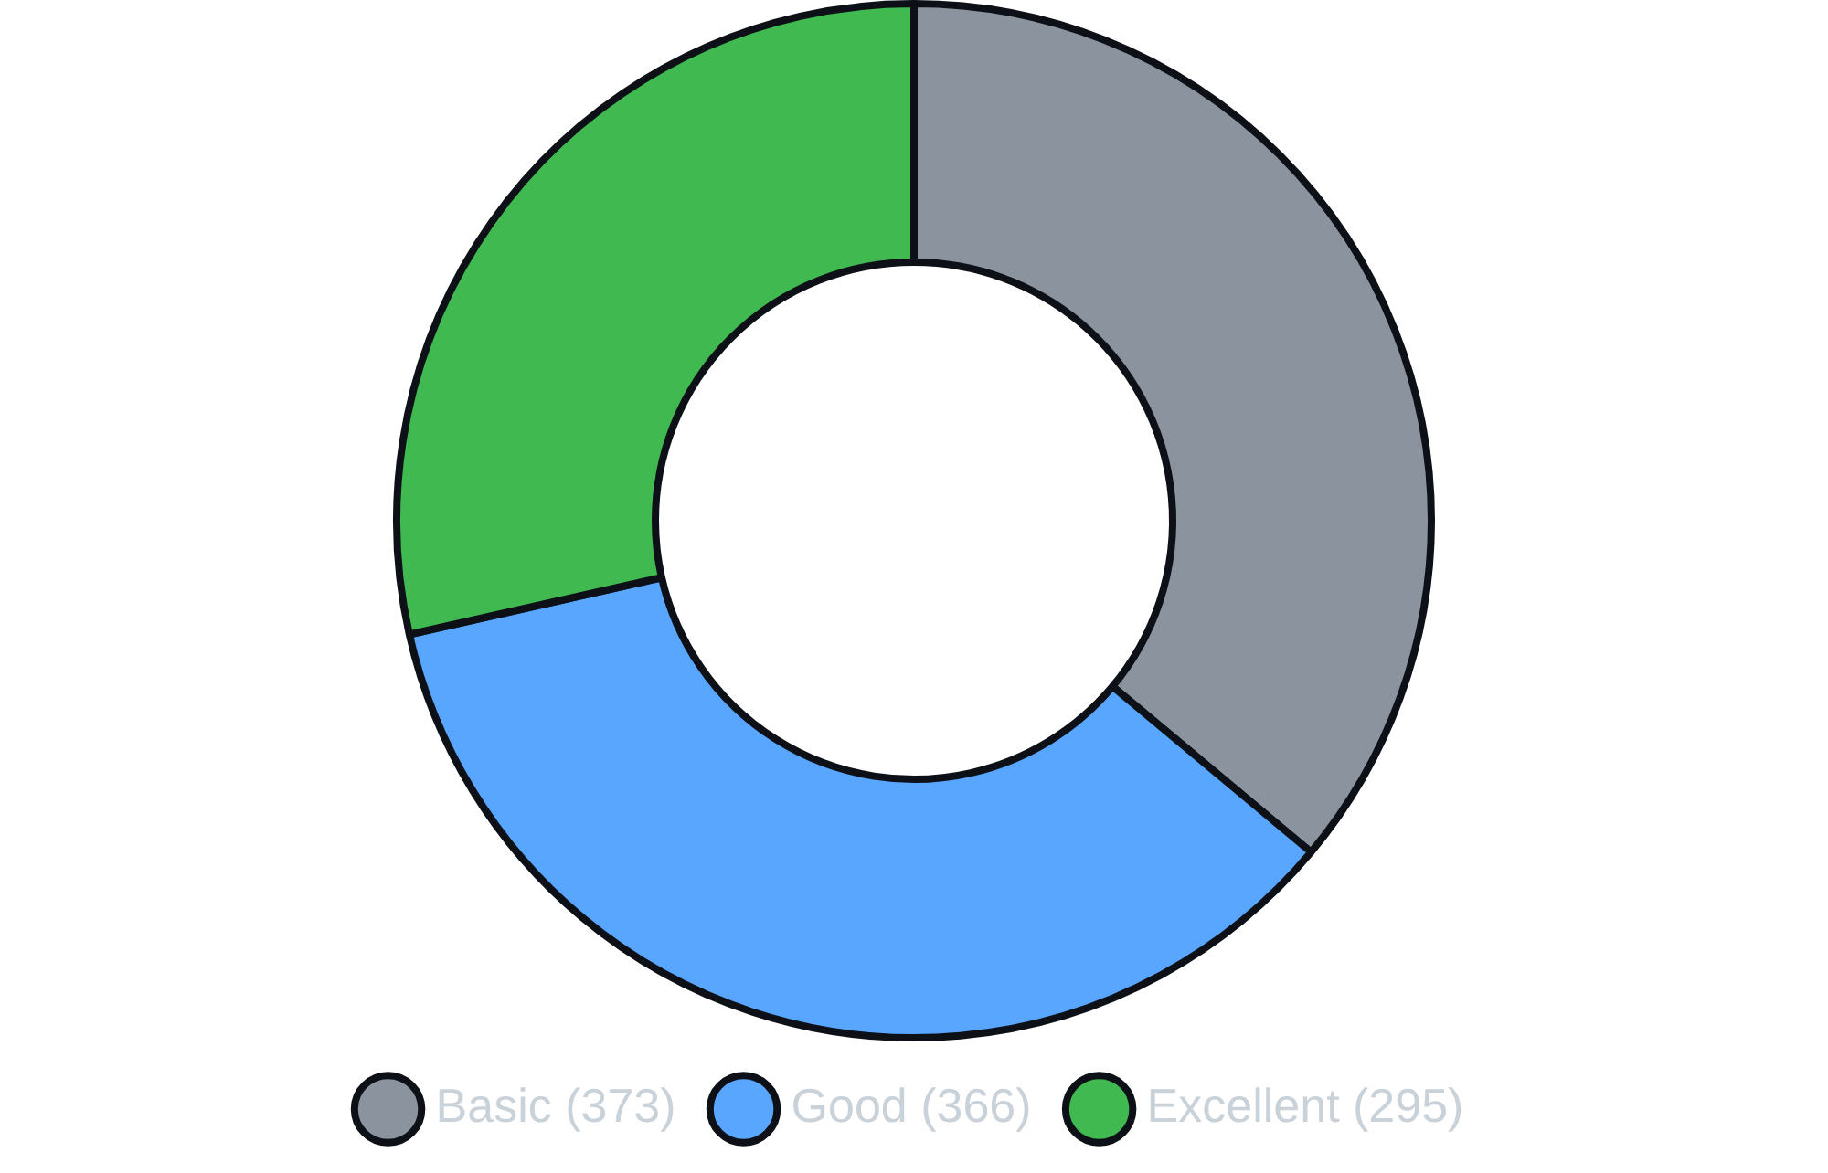
Repository Segmentation Analysis
High Growth Repositories Show Strong Correlation with Excellent Quality Ratings
Growth Segment Distribution
Quality Segment Distribution
438
295
155
High Growth Repos
Excellent Quality
High Growth + Excellent
42% of repositories show high growth signals, indicating active development ecosystems
28% achieve excellent quality ratings with all health indicators present
155 repositories combine high growth with excellent quality, representing top-tier projects

Slide 13

Top Performing Repositories
Elite Projects Demonstrate Excellence Across All Metrics with Exceptional Community Engagement
TensorFlow
React Native
PowerToys
C++ • Machine Learning
C++ • Mobile Framework
C# • System Utilities
Stars
192,085
Stars
124,204
Stars
124,775
Forks
74,915
Forks
24,893
Forks
7,426
Contributors
412
Contributors
305
Contributors
414
Maturity Score
Maturity Score
Maturity Score
90.86
85.24
94.03
Common Success Factors Across Elite Repositories
⭐
👥
📋
🚀
High Visibility
Large Teams
Complete Health
Active Development
100K+ stars indicating strong community recognition and trust
300+ contributors showing collaborative development at scale
All health indicators present: README, license, contributing, CoC
Sustained commit activity across all time windows with high velocity

Slide 14

Head-to-Head: TypeScript vs Rust - Metrics Comparison
Comparing Top Two Languages Across Key Performance Indicators
TypeScript
Rust
Type-Safe JavaScript for Modern Web Development
Memory-Safe Systems Programming Language
Overall Score
Overall Score
48.33
49.4
Activity Score
Activity Score
69.44
61.62
Health Score
Health Score
70.4
68.0
VS
Avg Contributors
Avg Contributors
311
258
Avg Stars
Avg Stars
68,602
34,618
Key Strengths
Key Strengths
Highest activity score (69.4)
Highest overall score (49.4)
Most contributors (311 avg)
Strong growth signal (0.62)
Strong enterprise adoption (40%)
Systems programming excellence
Excellent health indicators
Memory safety guarantees
Web/frontend dominance
High technical quality

Slide 15

Strategic Positioning & Use Cases
Choosing the Right Language for Your Project Requirements
TypeScript Excels At
Rust Excels At
Web Applications & Frontend Frameworks
Systems Programming
React, Angular, Vue.js ecosystems with type safety and IDE support
Memory safety without garbage collection, zero-cost abstractions
Large-Scale Collaborative Projects
Performance-Critical Applications
311 avg contributors, highest activity score enables team coordination
WebAssembly, game engines, embedded systems requiring speed
Enterprise Adoption
High Technical Quality
40% enterprise-ready rate, strong compliance and governance
Highest overall score (49.4), strong growth signal (0.62)
Enterprise Readiness
Growth Signal
TypeScript
40%
TypeScript
0.57
Rust
33%
Rust
0.62
When to Choose Each Language
Choose TypeScript When:
Choose Rust When:
Building web-first applications, need rapid development with large teams, require extensive library ecosystem, prioritize developer experience and tooling, or targeting enterprise environments with compliance requirements
Building systems-level software, need maximum performance and memory safety, developing for embedded or resource-constrained environments, creating WebAssembly modules, or require fine-grained control over system resources

Slide 16
Key Insights & Findings
Data-Driven Discoveries Reveal Clear Patterns in Language Ecosystem Success
01
02
Modern Languages Dominate Rankings
Activity Predicts Success Better Than Popularity
Rust, TypeScript, and Go emerge as top-tier languages with balanced strength across popularity, activity, and health dimensions, outperforming traditional languages by 10-15 points on average.
Activity metrics (commits, contributors) demonstrate strongest correlation with overall success (r=0.85), emphasizing importance of sustained development over initial star count.
Top 3: Rust (49.4), TypeScript (48.3), Go (46.9)
Activity-Overall: r=0.85 (R²=0.72)
vs Traditional: C# (36.8), Swift (37.4)
Popularity-Overall: r=0.57 (R²=0.33)

Slide 17

Key Insights & Findings - Part 2
Data-Driven Discoveries Reveal Clear Patterns in Language Ecosystem Success
03
04
Health Indicators Drive Community Trust
Python Popularity vs TypeScript Engagement
Health indicators (license, contributing guidelines, CoC) significantly impact repository success, with each adding 11-13 points to overall scores and fostering professional project management.
Python maintains dominance in absolute popularity (7.8M total stars) reflecting broad adoption, while TypeScript shows highest per-repository engagement (68,602 avg stars) indicating concentrated quality.
License impact: +11.88 points (p < 0.0001)
Python: 78,107 avg stars, 227 contributors
Contributing/CoC: +12.7 points each
TypeScript: 68,602 avg stars, 311 contributors
Statistical analysis confirms
significant differences between language groups
, validating ecosystem-level variations beyond
individual project quality. These insights provide
actionable guidance for developers and organizations
making strategic
technology decisions.

Slide 18

Strategic Recommendations for Language Selection
Data-Driven Guidance for Technology Investment Decisions Based on Use Case Requirements
Web & Frontend Development
Systems & Performance-Critical
TypeScript + JavaScript
Rust + C++
Choose TypeScript for large-scale web applications requiring type safety and enterprise-grade tooling. Highest activity score (69.4) and contributor engagement (311 avg) ensure robust ecosystem support.
Select Rust for memory-safe systems programming with modern tooling. Top overall score (49.4) and strong growth signal (0.62) indicate sustained innovation. C++ remains viable for legacy integration.
Cloud & Backend Services
Enterprise Applications
Go + Python
TypeScript + C#
Go excels in microservices and cloud infrastructure with balanced metrics (46.9 overall). Python dominates data science and ML with highest popularity (78K avg stars) and broad library support.
TypeScript leads enterprise readiness (40%) with superior compliance scores. C# offers strong Microsoft ecosystem integration. Both demonstrate excellent health indicators and professional governance.

Slide 19
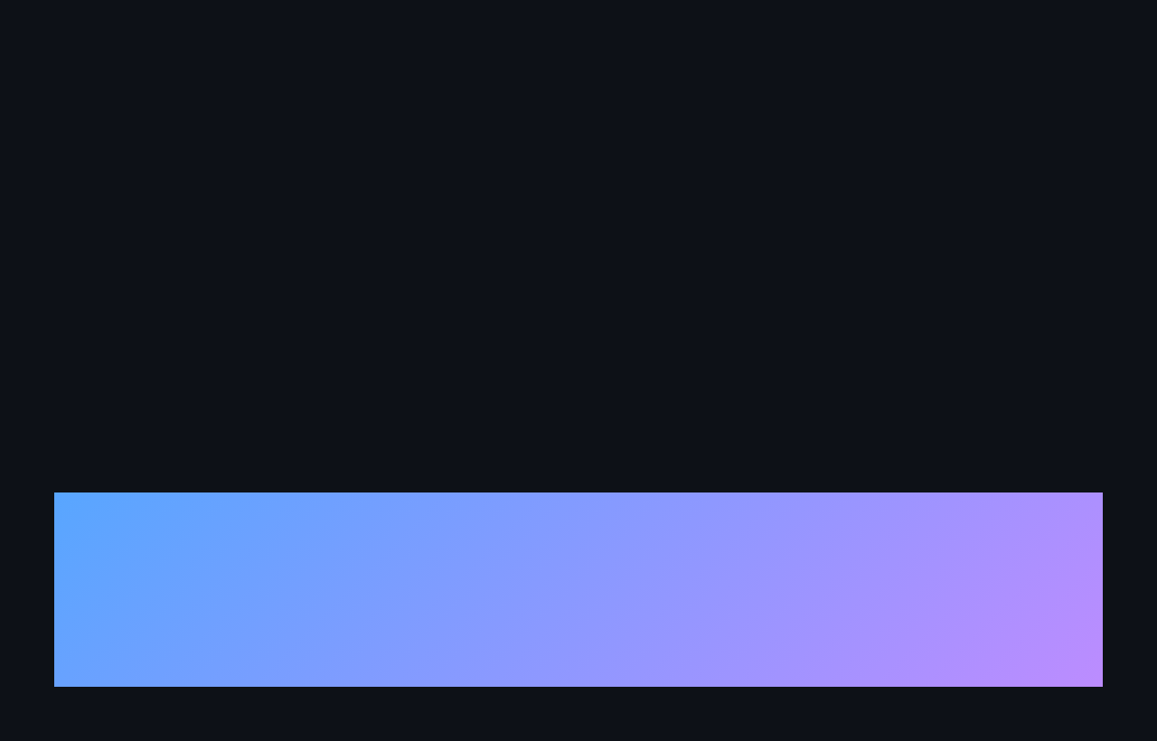
Future Trends & Conclusions
Predictions and Strategic Guidance for the Evolving Language Ecosystem
Future Trends & Predictions
Rising Stars
Ecosystem Maturation
Activity Over Popularity
Rust and TypeScript will continue rapid growth, driven by memory safety demands and web platform evolution
Health indicators becoming standard requirements as open source projects adopt enterprise governance practices
Organizations increasingly prioritize active development and contributor engagement over historical star counts
Leverage data-driven insights to make informed technology decisions. Choose languages based on empirical evidence of ecosystem health, community engagement, and sustained development activity.

